Slide 1
Welcome!
Hari Polnati

Slide 2
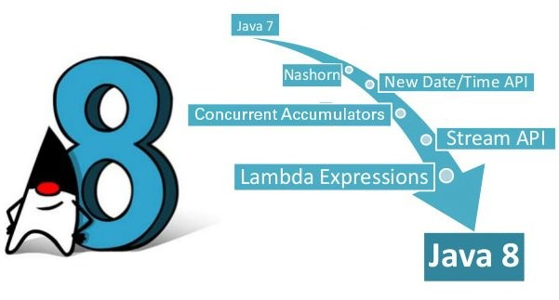
Agenda
Programming paradigms
Functional Programming
Lambdas
Functional Interfaces
Method references
Stream API
New Date API
Java 11 Features

Slide 3
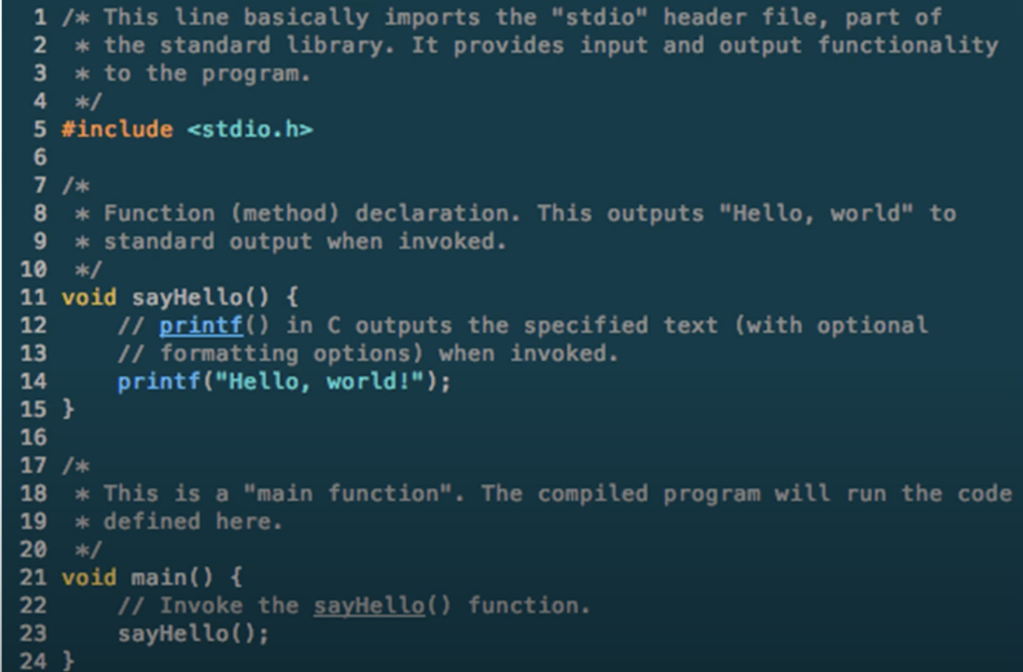
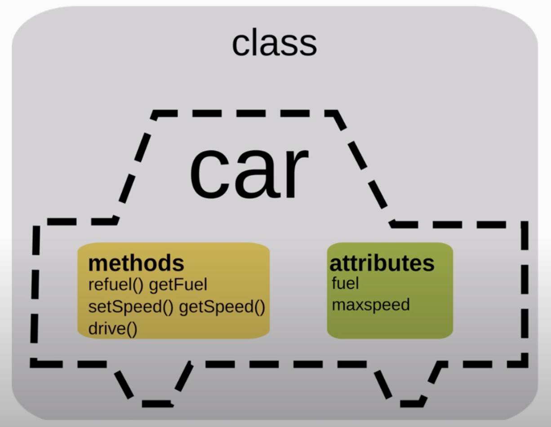
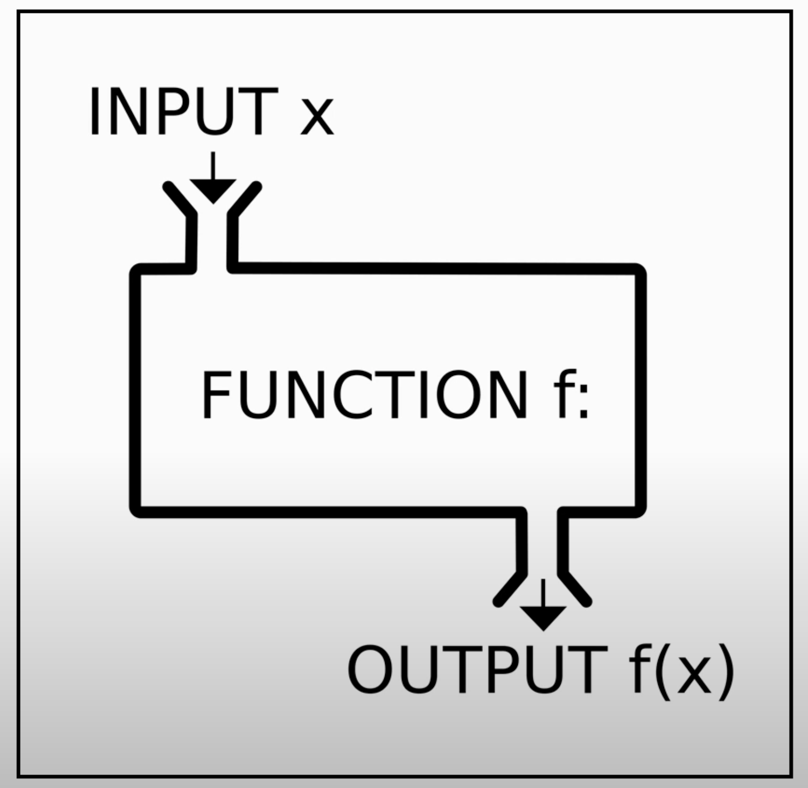
Programming Paradigms - How code is organized/structured
Procedure Oriented
Object-Oriented
Functional Oriented
Procedure
Object-Oriented
Functional

Slide 4
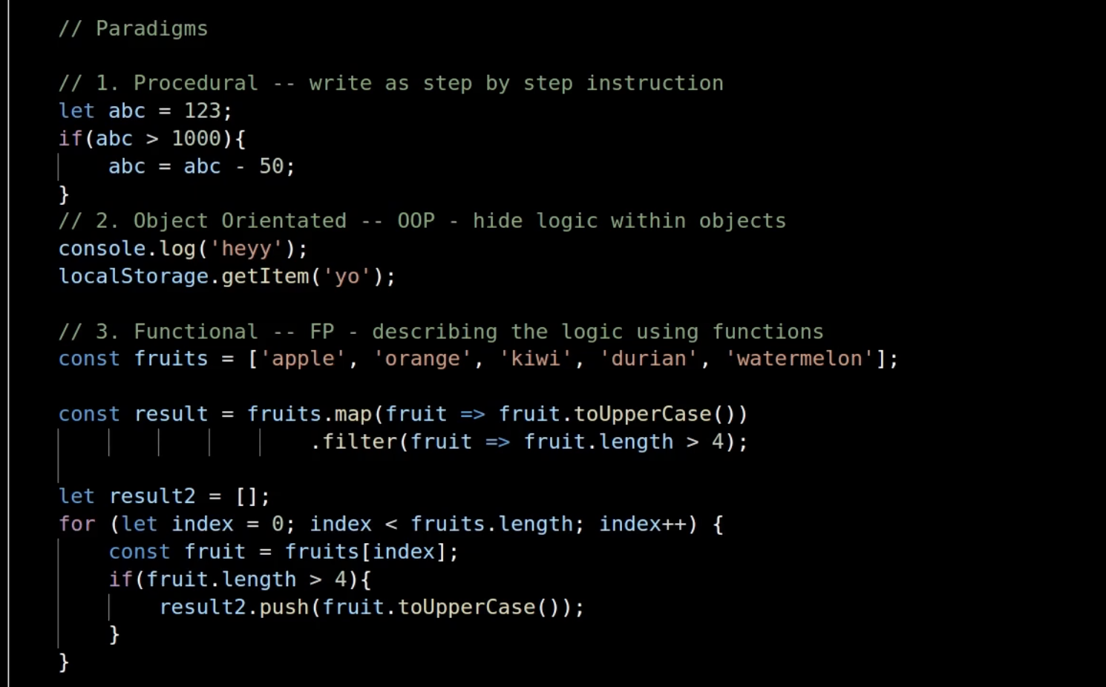
Another example!

Slide 6
Functional Programming
- Functions are first class citizens

Slide 7
Let’s Understand Object Composition and Function Composition
Object Composition:
So far what we done is:
We can pass object to function
We can create objects inside function
We can return objects from functions
Addition to object composition we can function composition:
Higher Order functions:
We can pass function to function
We can create function within function
We can return function from functions
Functions have to be pure and doesn’t have side effects:
Doesn’t change anything.
Doesn’t depend on anything that changes

Slide 8
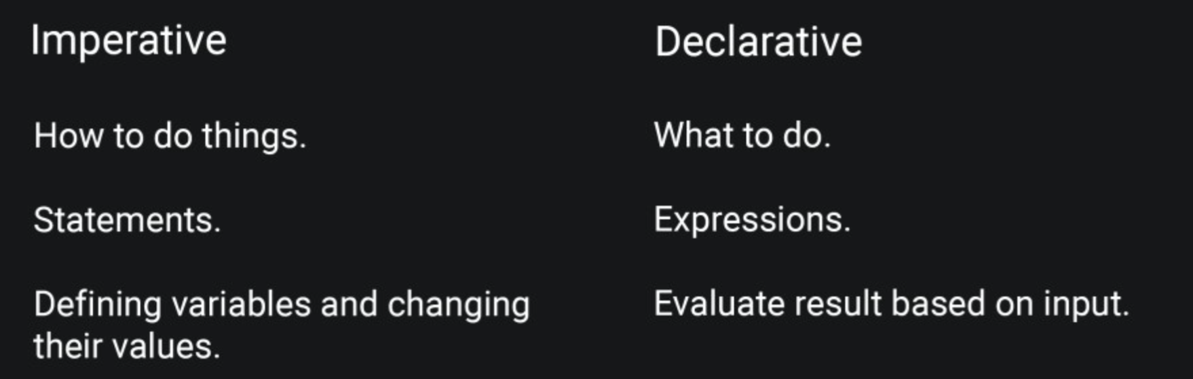
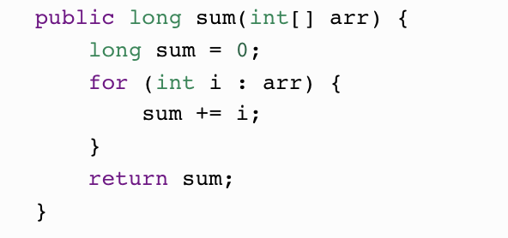
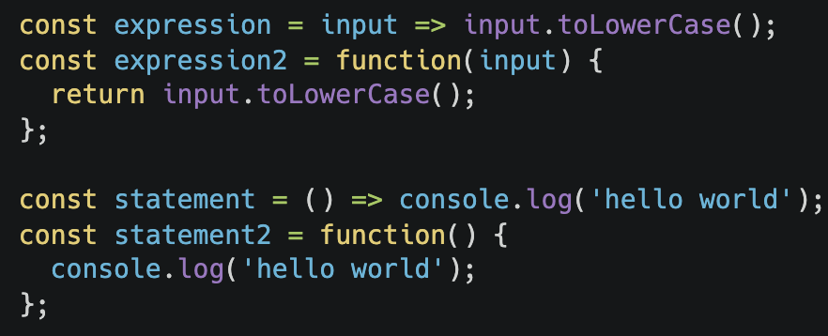
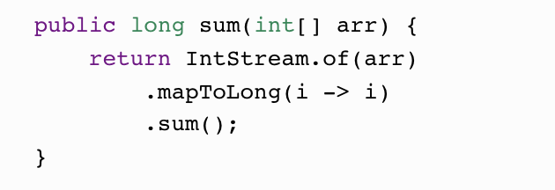
Imperative vs Declarative
In imperative programming, your code is based on statements that change the program state by telling the computer how to do things. In other words, your code is based on defining variables and changing the values of those variables.
In declarative programming, your code is based on expressions that evaluate their result based on their input by telling the computer what you want.
In declarative functional programming, changing the external state or causing external actions such as write data to log file, saving a file, or loading database record is called a side effect.
Changing a value of anything is called a mutation
Imperative
Declarative

Slide 9
Code in OOP
Everything is an object
All code blocks are “associated” with classes and objects

Slide 10
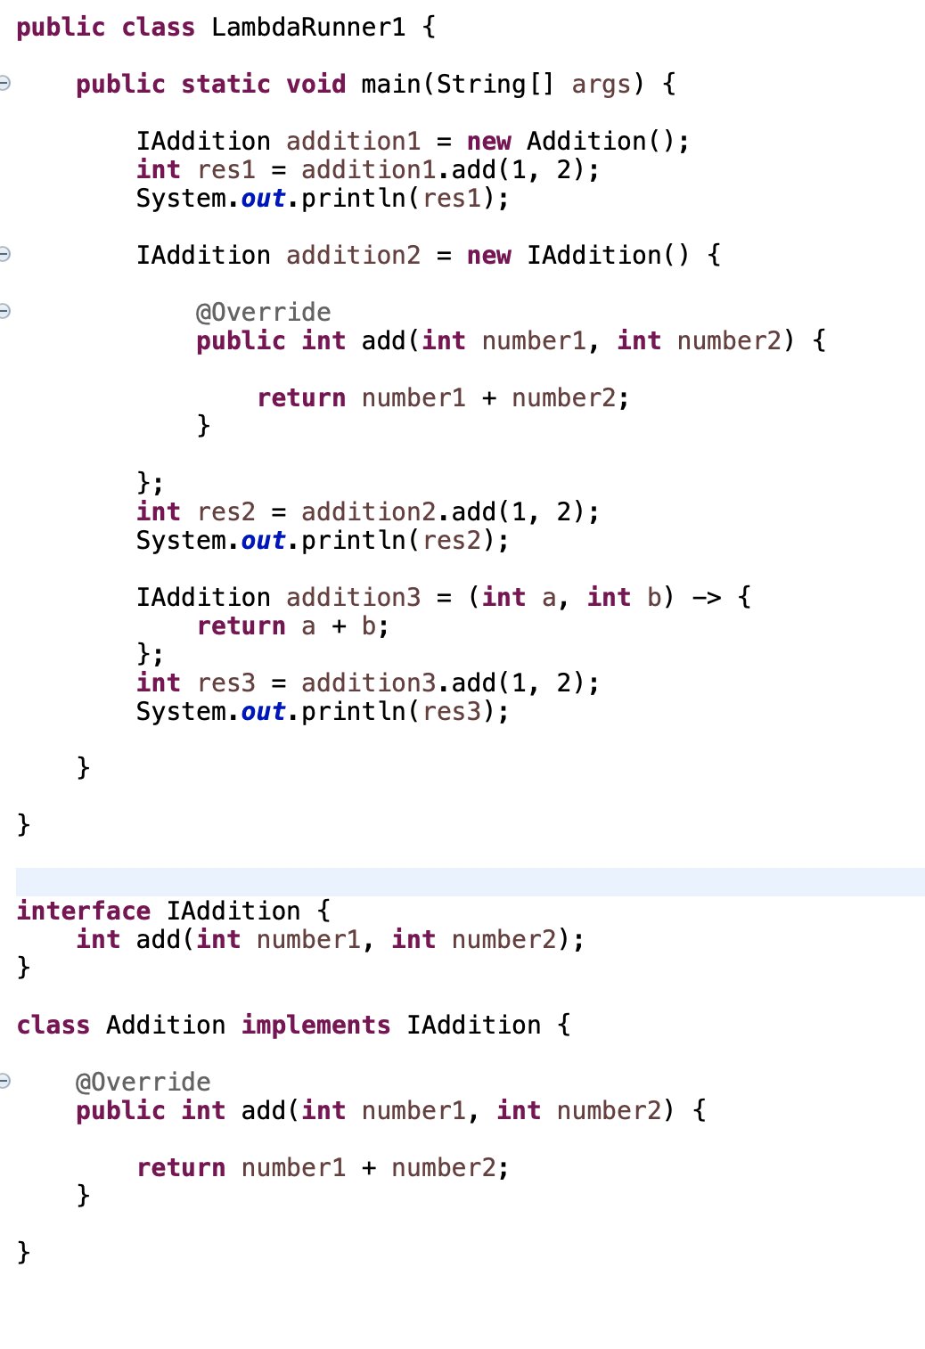

Slide 11
Functional programming
A style of programming that treats computation as the evaluation of mathematical functions
Eliminates side effects
Treats data as being immutable
Expressions have referential transparency
Functions can take functions as arguments and return functions as results
Allows us to write easier-to-understand, more declarative, more concise programs than imperative programming
Allows us to focus on the problem rather than the code
Facilitates parallelism

Slide 12
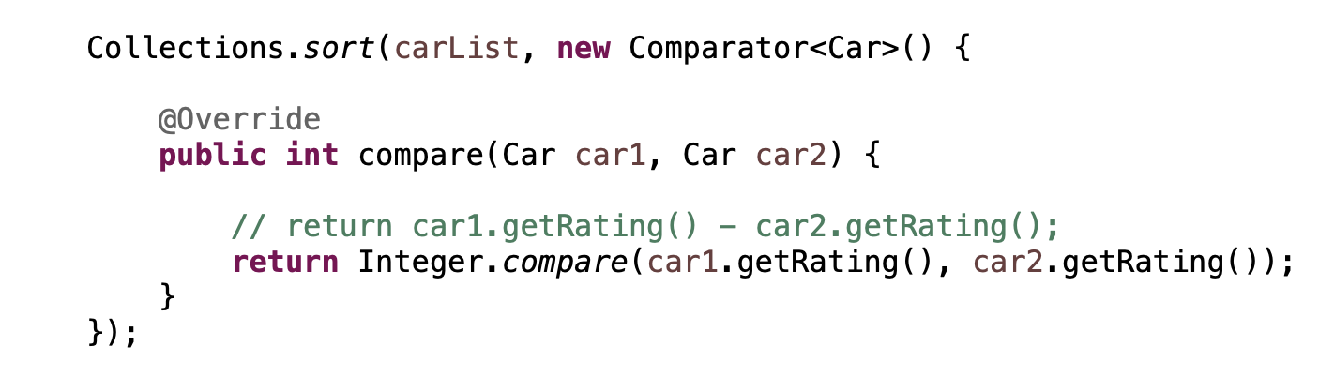

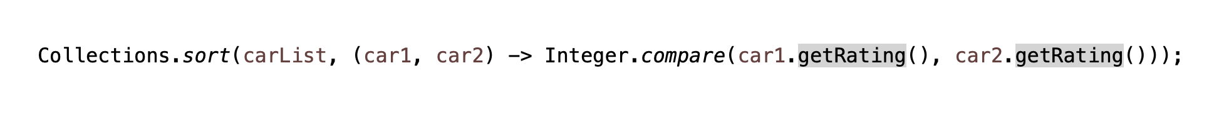

A function has 4 things:
1.Name
2. Return type
3.Parameter list
4.Body
Lambda Expression:
(parameter list) -> body
Or
Or

Slide 13
Java 8 Lambda --Special types of Anonymous Inner class (SAM/FI)
A Java 8 lambda is basically a method in Java without a declaration usually written as (parameters) -> { body }.
Examples,
(int x, int y) -> { return x + y; }
x -> x * x
( ) -> x
A lambda can have zero or more parameters separated by commas and their type can be explicitly declared or inferred from the context.
Parenthesis are not needed around a single parameter.
( ) is used to denote zero parameters.
The body can contain zero or more statements.
Braces are not needed around a single-statement body.

Slide 14
Benefits of Lambda
Enabling functional programming
Writing leaner more compact code
Facilitating parallel programming
Developing more generic, flexible and reusable APIs
Being able to pass behaviors as well as data to functions

Slide 15
Functional Interface
An interface
With one abstract method
Methods from Object class doesn’t count
Annotated with @FunctionalInterface
A functional interface can be implemented with lambda
Design decision: Java 8 lambdas are assigned to functional interfaces.
A functional interface is a Java interface with exactly one non-default method. E.g.,
public interface Consumer<T> {
void accept(T t);
}
The package java.util.function defines many new useful functional interfaces.
Examples of FI:
Runnable
Callable
Comparable
Java SE 8 Adds:
Function<T,R>
Predicate<T>
Supplier<T>
Consumer<T>
See java.util.function interface

Slide 16
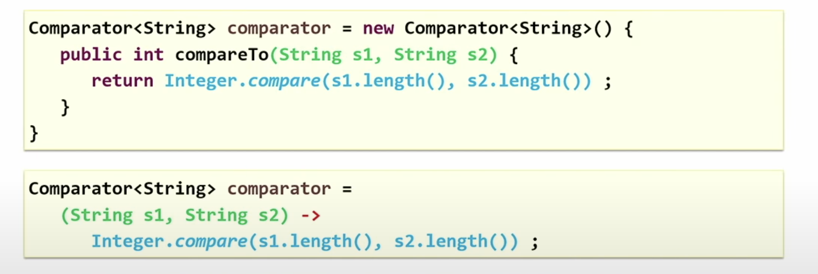
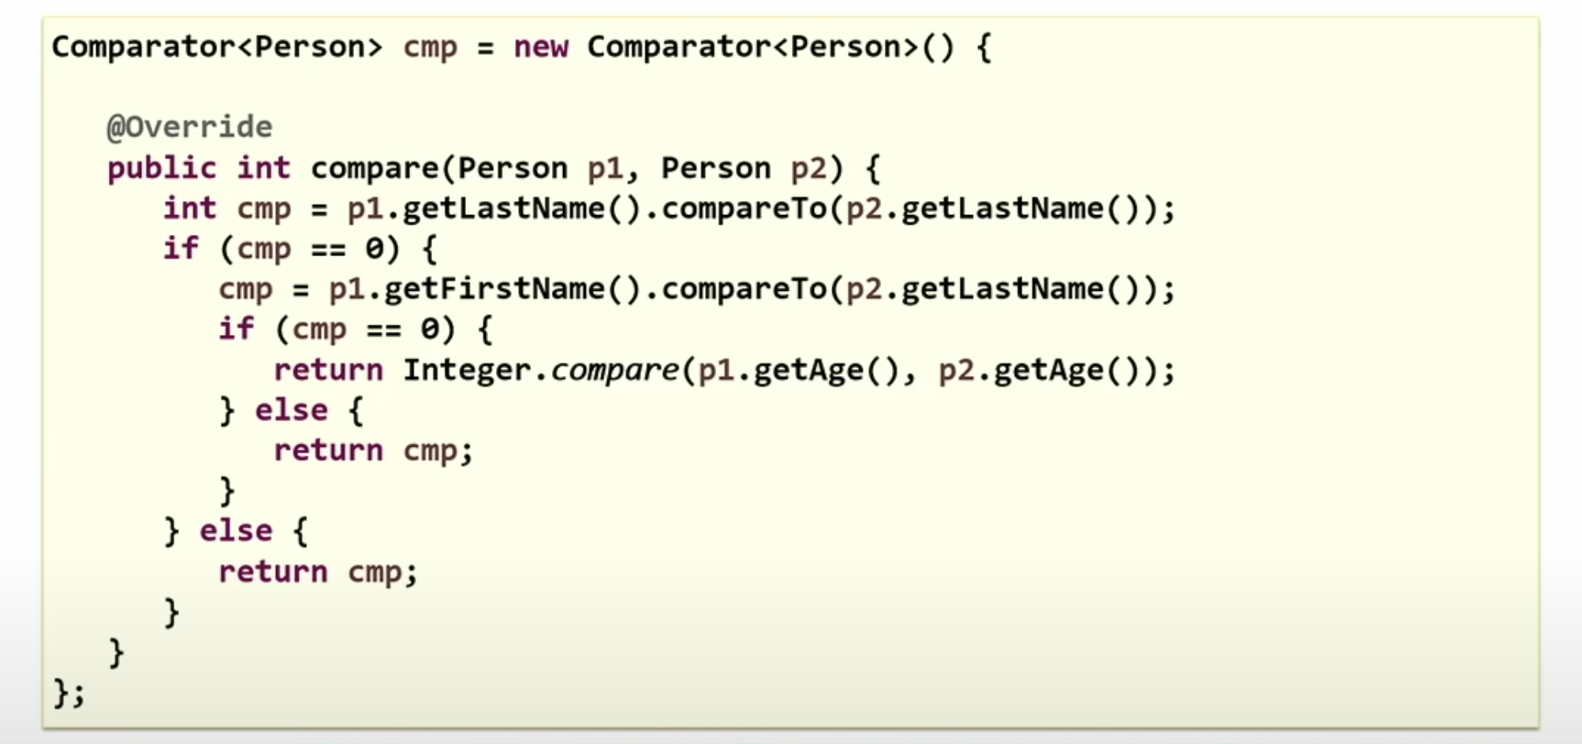
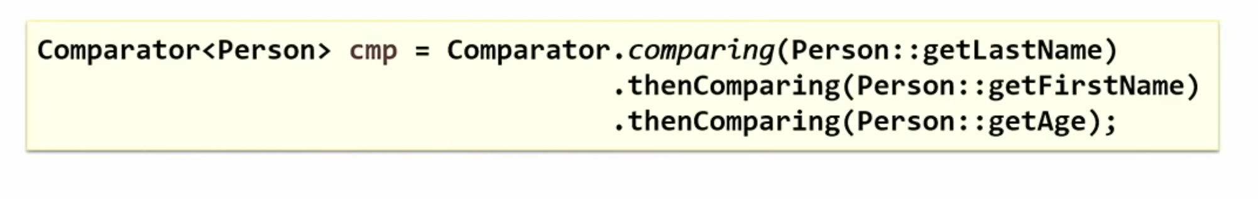
Example1:
Example2:

Slide 17
Functional Interface and Lambda
The functional interface is an interface with one abstract method, but it can have any number of default and static methods. The Runnable and Comparable interface are examples of a functional interface.
@FunctionalInterface
interface Greet
{
public void sayHi(String str);
//default
//static
}
The lambda expression is an anonymous method (a method without a name) that is used to implement the abstract method of the functional interface.
Example: (str) - > System.out.println(str);

Slide 18
Method References
Event more brief and clearly expressive way to implement functional interfaces
Format: <Class or Instance>::<Method>
Example (Functional Interface)
public interface IntPredicates {
boolean isOdd(Integer n) { return n % 2 != 0; }
}
Example (Call with Lambda Expression)
List<Integer> numbers = asList(1,2,3,4,5,6,7,8,9);
List<Integer> odds = filter(n -> IntPredicates.isOdd(n), numbers);
Example (Call with Method Reference)
List<Integer> numbers = asList(1,2,3,4,5,6,7,8,9);
List<Integer> odds = filter(IntPredicates::isOdd, numbers);

Slide 19
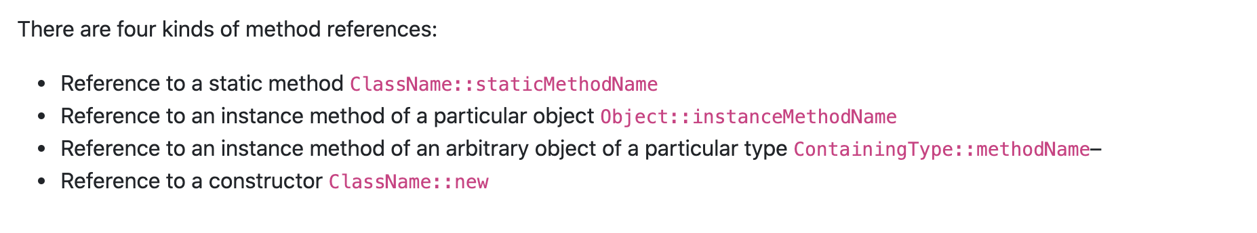
Method References continues..

